Slide 1

Chapter 4: Project Integration Management
Information Technology Project Management, Seventh Edition
ĐẶNG THỊ THU HÀ – SE
dtthuha79@gmail.com
https://lms.iuh.edu.vn
.

Slide 2
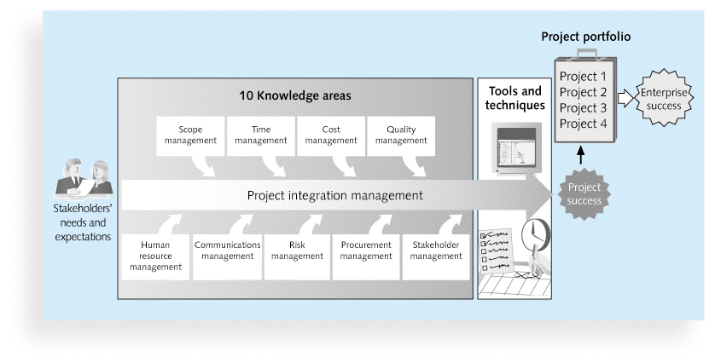

Slide 3
Learning Objectives
Describe an overall framework for project integration management as it relates to the other project management knowledge areas and the project life cycle
Explain the importance of creating a project charter to formally initiate projects
Understand the integrated change control process, planning for and managing changes on information technology (IT) projects, and developing and using a change control system
Explain the importance of developing and following good procedures for closing projects

Slide 4
Project Integration Management Processes
4.1.Developing the project charter involves working with stakeholders to create the document that formally authorizes a project—the charter.
4.2.Developing the project management plan involves coordinating all planning efforts to create a consistent, coherent document—the project management plan.
4.3.Directing and managing project work involves carrying out the project management plan by performing the activities included in it.

Slide 5
Project Integration Management Processes (cont’d)
4.4.Monitoring and controlling project work involves overseeing activities to meet the performance objectives of the project
4.5.Performing integrated change control involves identifying, evaluating, and managing changes throughout the project life cycle.
4.6.Closing the project or phase involves finalizing all activities to formally close the project or phase.

Slide 6
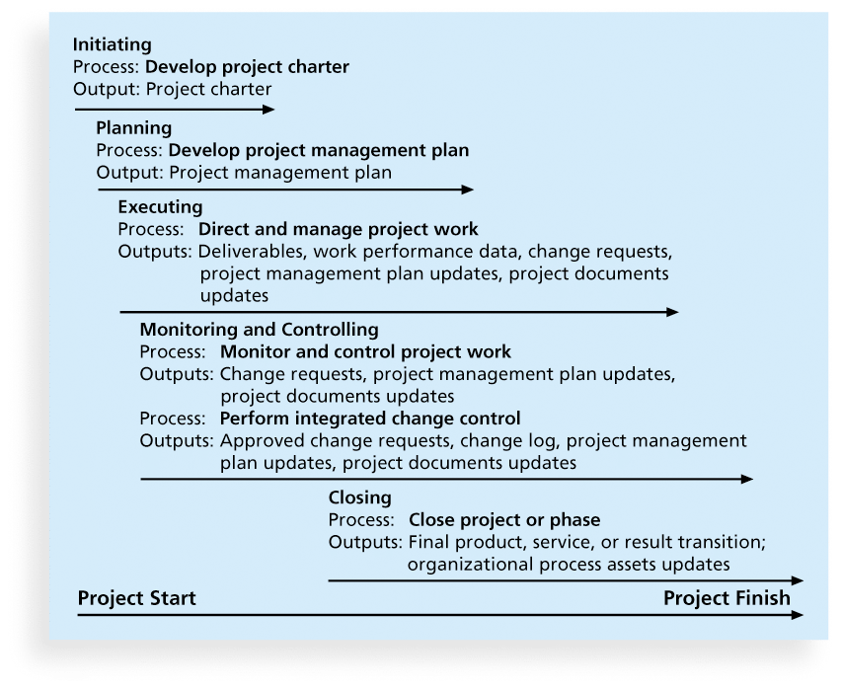
Figure 4-1. Project Integration Management Summary

Slide 7
4.1.Developing a Project Charter
A project charter is a document that formally recognizes the existence of a project and provides direction on the project’s objectives and management
Key project stakeholders should sign a project charter to acknowledge agreement on the need and intent of the project; a signed charter is a key output of project integration management

Slide 8
Inputs for Developing a Project Charter
A project statement of work
A business case (customer)
Agreements ()
Enterprise environmental factors ()
Organizational process assets, which include formal and informal plans, policies, procedures, guidelines, information systems, financial systems, management systems, lessons learned, and historical information
Notes:
Nội dung quy trình theo tổ chức

Slide 9
Project charter elements
1. Project title
2. Date Authorization
3. Start Date Finish Date
4. Key Schedule Milestones
5. Budget:
6. Project Manager
7. Project Objectives
8. Main Project Success Criteria
9. Approach
10. Role of Responsibilities: Name, Role, Position, Information Contact
11. Sign-off

Slide 10
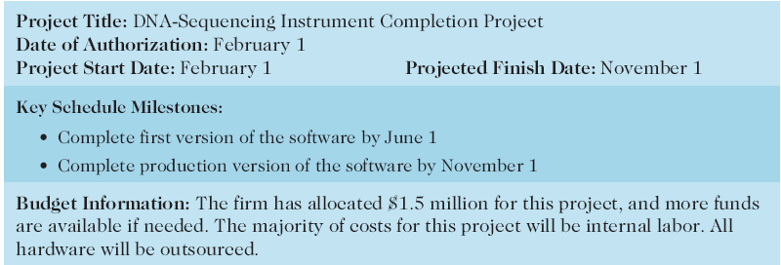
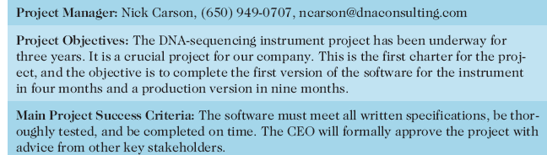

Slide 11
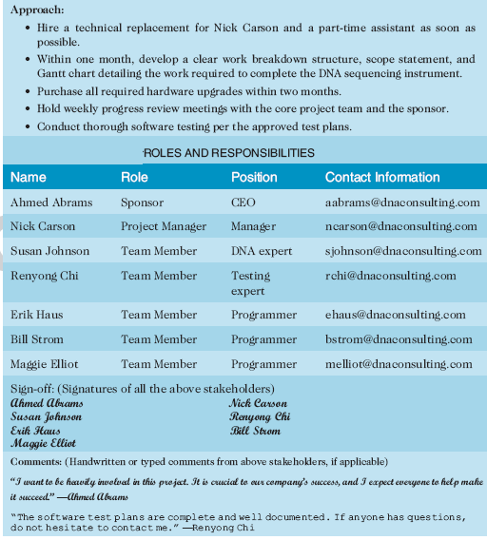

Slide 12
4.2.Developing a Project Management Plan
A project management plan is a document used to coordinate all project planning documents and help guide a project’s execution and control
Plans created in the other knowledge areas are subsidiary parts of the overall project management plan

Slide 13
Common Elements of a Project Management Plan
Introduction or overview of the project
Description of how the project is organized
Management and technical processes used on the project
Work to be done, schedule, and budget information

Slide 14
4.3.Directing and Managing Project Work
Involves managing and performing the work described in the project management plan
The majority of time and money is usually spent on execution
The application area of the project directly affects project execution because the products of the project are produced during execution
Project planning and execution are intertwined and inseparable activities

Slide 15
Capitalizing on Product, Business, and Application Area Knowledge
It is often helpful for IT project managers to have prior technical experience
On small projects, the project manager may be required to perform some of the technical work or mentor team members to complete the projects
On large projects, the project manager must understand the business and application area of the project

Slide 16
Project Execution Tools and Techniques
Expert judgment: Experts can help project managers and their teams make many decisions related to project execution
Meetings: Meetings allow people to develop relationships, pick up on important body language or tone of voice, and have a dialogue to help resolve problems.
Project management information systems: There are hundreds of project management software products available on the market today, and many organizations are moving toward powerful enterprise project management systems that are accessible via the Internet

Slide 17
4.4.Monitoring and Controlling Project Work
Changes are inevitable on most projects, so it’s important to develop and follow a process to monitor and control changes
Monitoring project work includes collecting, measuring, and disseminating performance information
A baseline is the approved project management plan plus approved changes
Notes:
inevitable không thể tránh khỏi

Slide 18
4.5.Performing Integrated Change Control
Three main objectives are:
Influencing the factors that create changes to ensure that changes are beneficial
Determining that a change has occurred
Managing actual changes as they occur
Notes:
Tác động đến các yếu tố tạo ra thay đổi để đảm bảo rằng những thay đổi đó có lợi
Xác định rằng một thay đổi đã xảy ra
Quản lý các thay đổi thực tế khi chúng xảy ra

Slide 19
Change Control on Information Technology Projects
Former view: The project team should strive to do exactly what was planned on time and within budget
Problem: Stakeholders rarely agreed up-front on the project scope, and time and cost estimates were inaccurate
Modern view: Project management is a process of constant communication and negotiation
Solution: Changes are often beneficial, and the project team should plan for them
Notes:
Former view: Cách nhìn thông thường
strive : cố gắng
Modern view: Cách nhìn hiện đại

Slide 20
Change Control System
A change control system is a formal, documented process that describes when and how official project documents and work may be changed
Describes who is authorized to make changes and how to make them

Slide 21
Change Control Board (CCB)
A change control board is a formal group of people responsible for approving or rejecting changes on a project
CCBs provide guidelines for preparing change requests, evaluate change requests, and manage the implementation of approved changes
CCB Includes stakeholders from the entire organization such as Project Manager, sponsor, customer, expert, FM (Functional Manager)…
Notes:
Không phải Project Manager luôn là người đồng ý hay từ chối change request, đó có một bộ phận riêng chuyên làm việc đó gọi là Change Control Board (CCB). Ở một số quy mô dự án nhỏ Project Manager có thể có authority lớn và có chuyên môn chính trong lĩnh vực dự án là người quyết định chính, còn CCB có thể gồm nhiều thành viên hơn thế.
CCB có thể gồm các thành phần sau: Project Manager, sponsor, customer, expert, FM (Functional Manager)…
Approve: thừa nhận, chấp nhận

Slide 22
4.6.Closing Projects or Phases
To close a project or phase, you must finalize all activities and transfer the completed or cancelled work to the appropriate people
Main outputs include
Final product, service, or result transition
Organizational process asset updates

Slide 23
Chapter Summary
Project integration management involves coordinating all of the other knowledge areas throughout a project’s life cycle
Main processes include
Develop the project charter
Develop the project management plan
Direct and manage project execution
Monitor and control project work
Perform integrated change control
Close the project or phase

Slide 24
Bài tập
Phát triển dự án về phần mềm quản lý nhà thuốc
Yêu cầu:
Project Charter → File word (15’)

